Slide 1

Group
4
Yelp
Business-Focused Analysis
INSY 662 — Team Project 3
By: Lindsay Yang, Leah Ma, JunKang Zhang, Chris Zong

Slide 2
Roadmap
3
Business Idea
1
Data Mining Techniques
Improvements
& Suggestions
2
Data Cleaning Selection Process

Slide 3
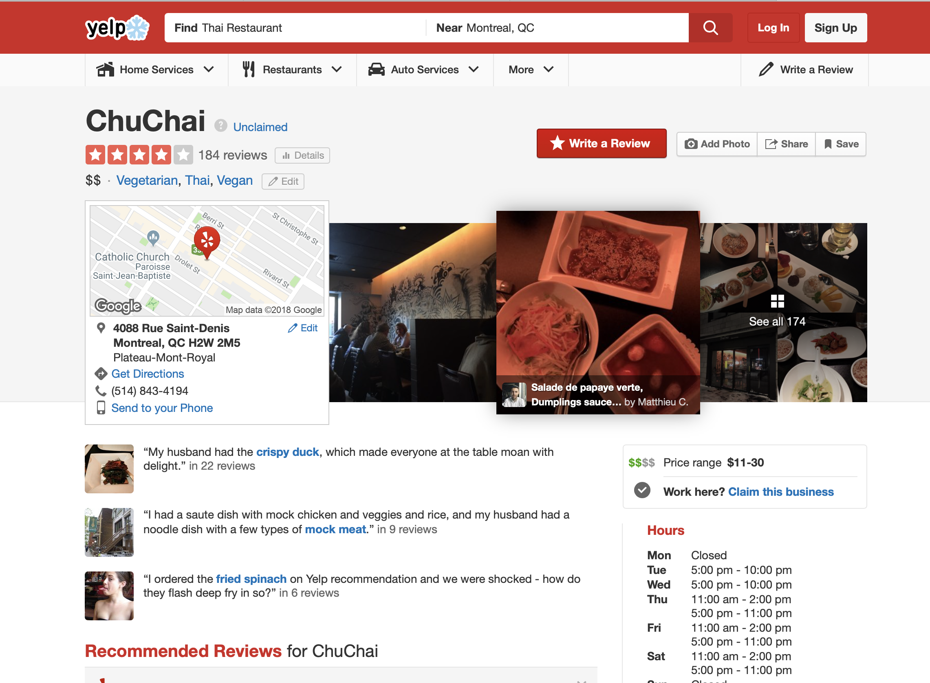
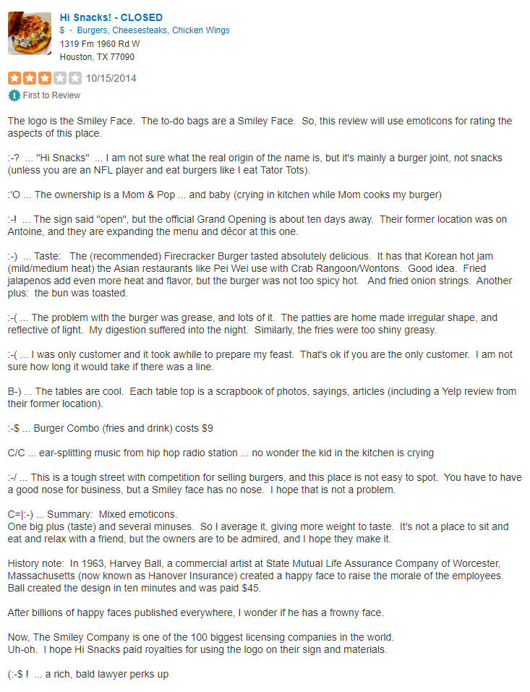
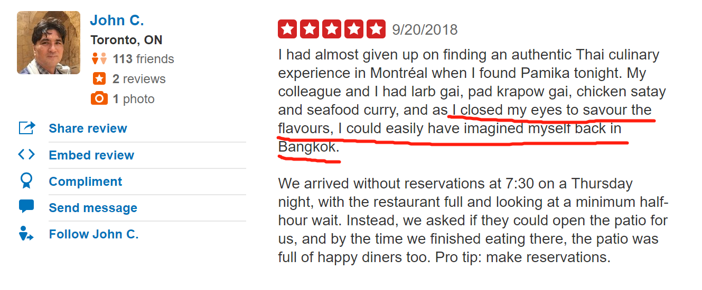
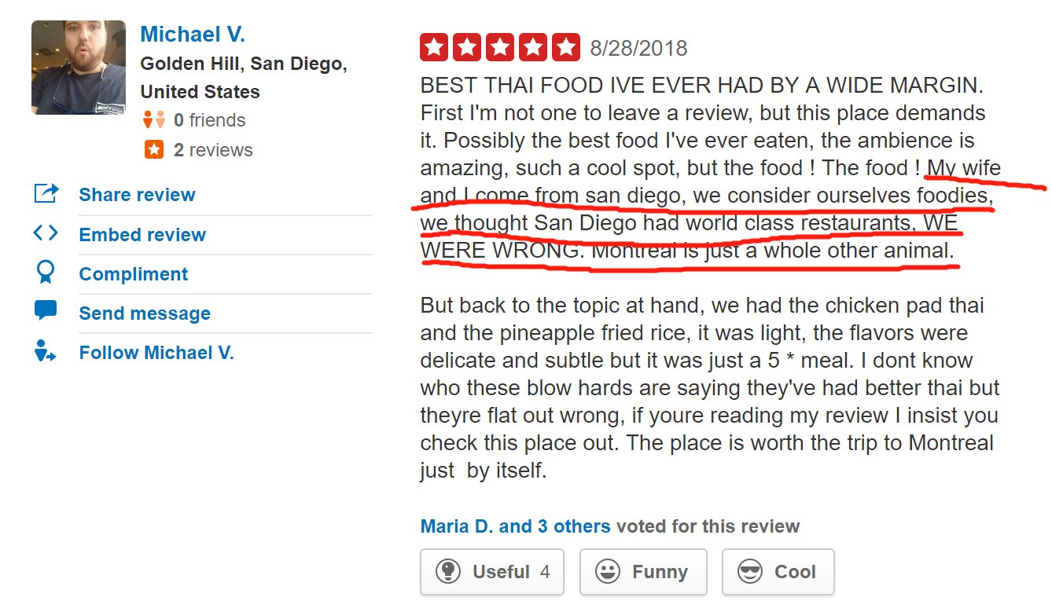
Business Idea
Improve Feature:
Tags & Keywords
Not everyone will read through entire review
Not every review has meaning content
Increase relevance to search ranking
New feature to add value for businesses
Notes:
our intention

Slide 4
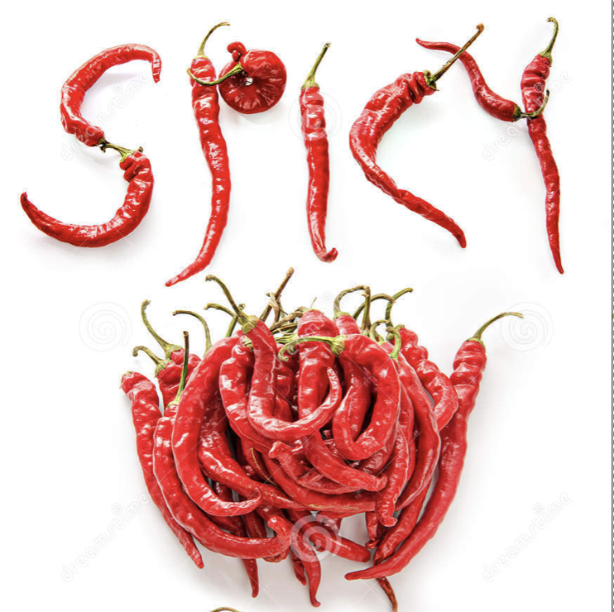

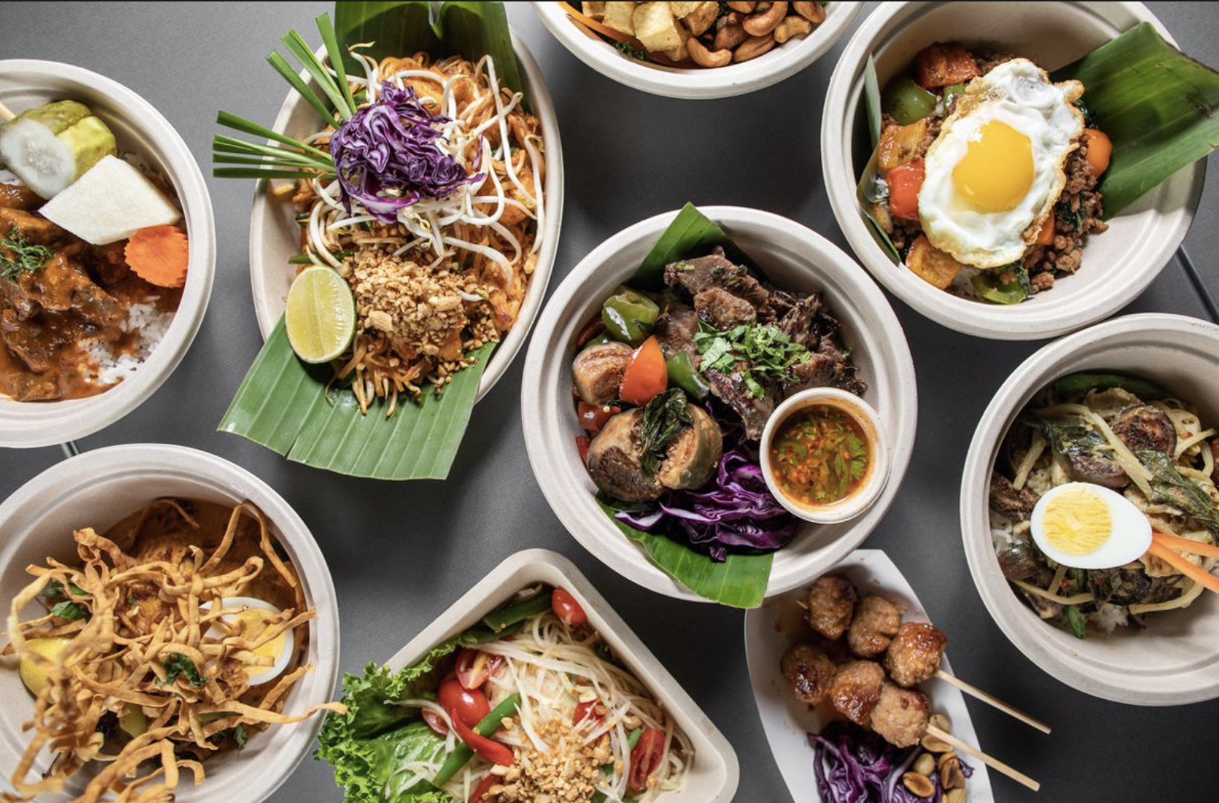
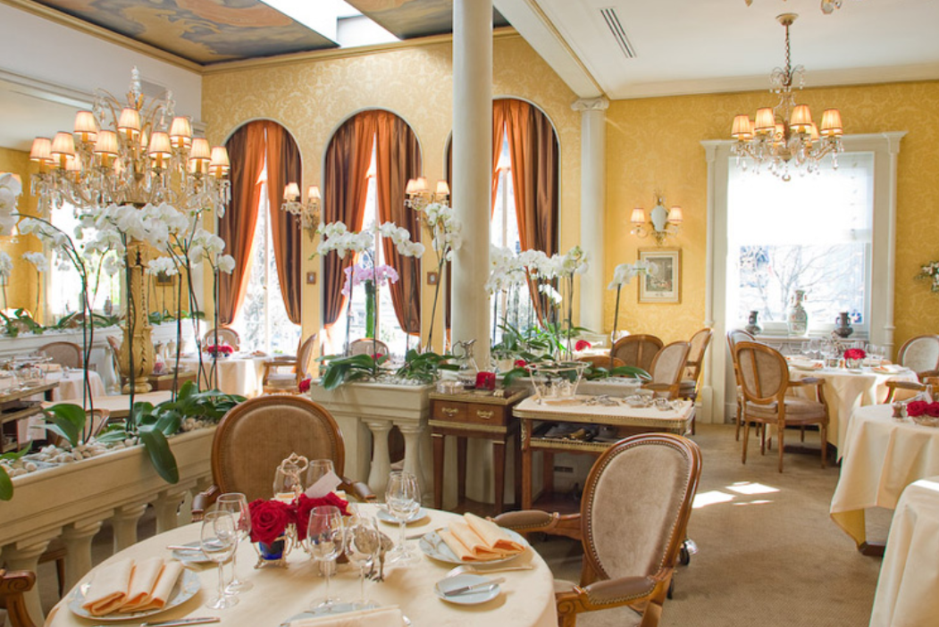
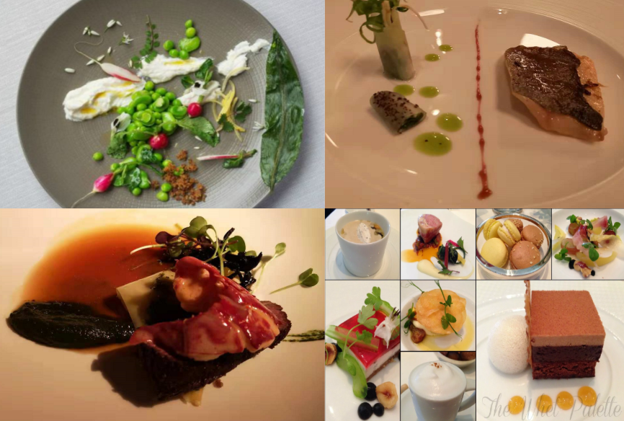

Keywords Extraction

Slide 5







Initial Data
yelp_business
yelp_reviews
yelp_business_attributes
yelp_checkin
yelp_busines_hours
yelp_tip
yelp_user
Notes:
7 tables, focused on 2

Slide 6
Data
Selection
Process

Slide 7







Size Down
1
Restaurants
170K -> 56K
Open Canadian Restaurants
2
56K -> 14K
3
K – Means Cluster
14K -> 1107
Keywords Selection
Predictors Creation
High-frequency words from randomly selected from review comments
Create columns by review text processing of key words selected
4
8
1107 -> 540
High Rating Business
Merge
200K
5
10
110K
Merge
Review Text Scraping
64
6
9
11
13605
Text Mining
Group & Sum
200K -> 1107
7
12
13605 -> 64
Key Words
Data Set
13
Random Forest, KNN & SVR

Slide 8

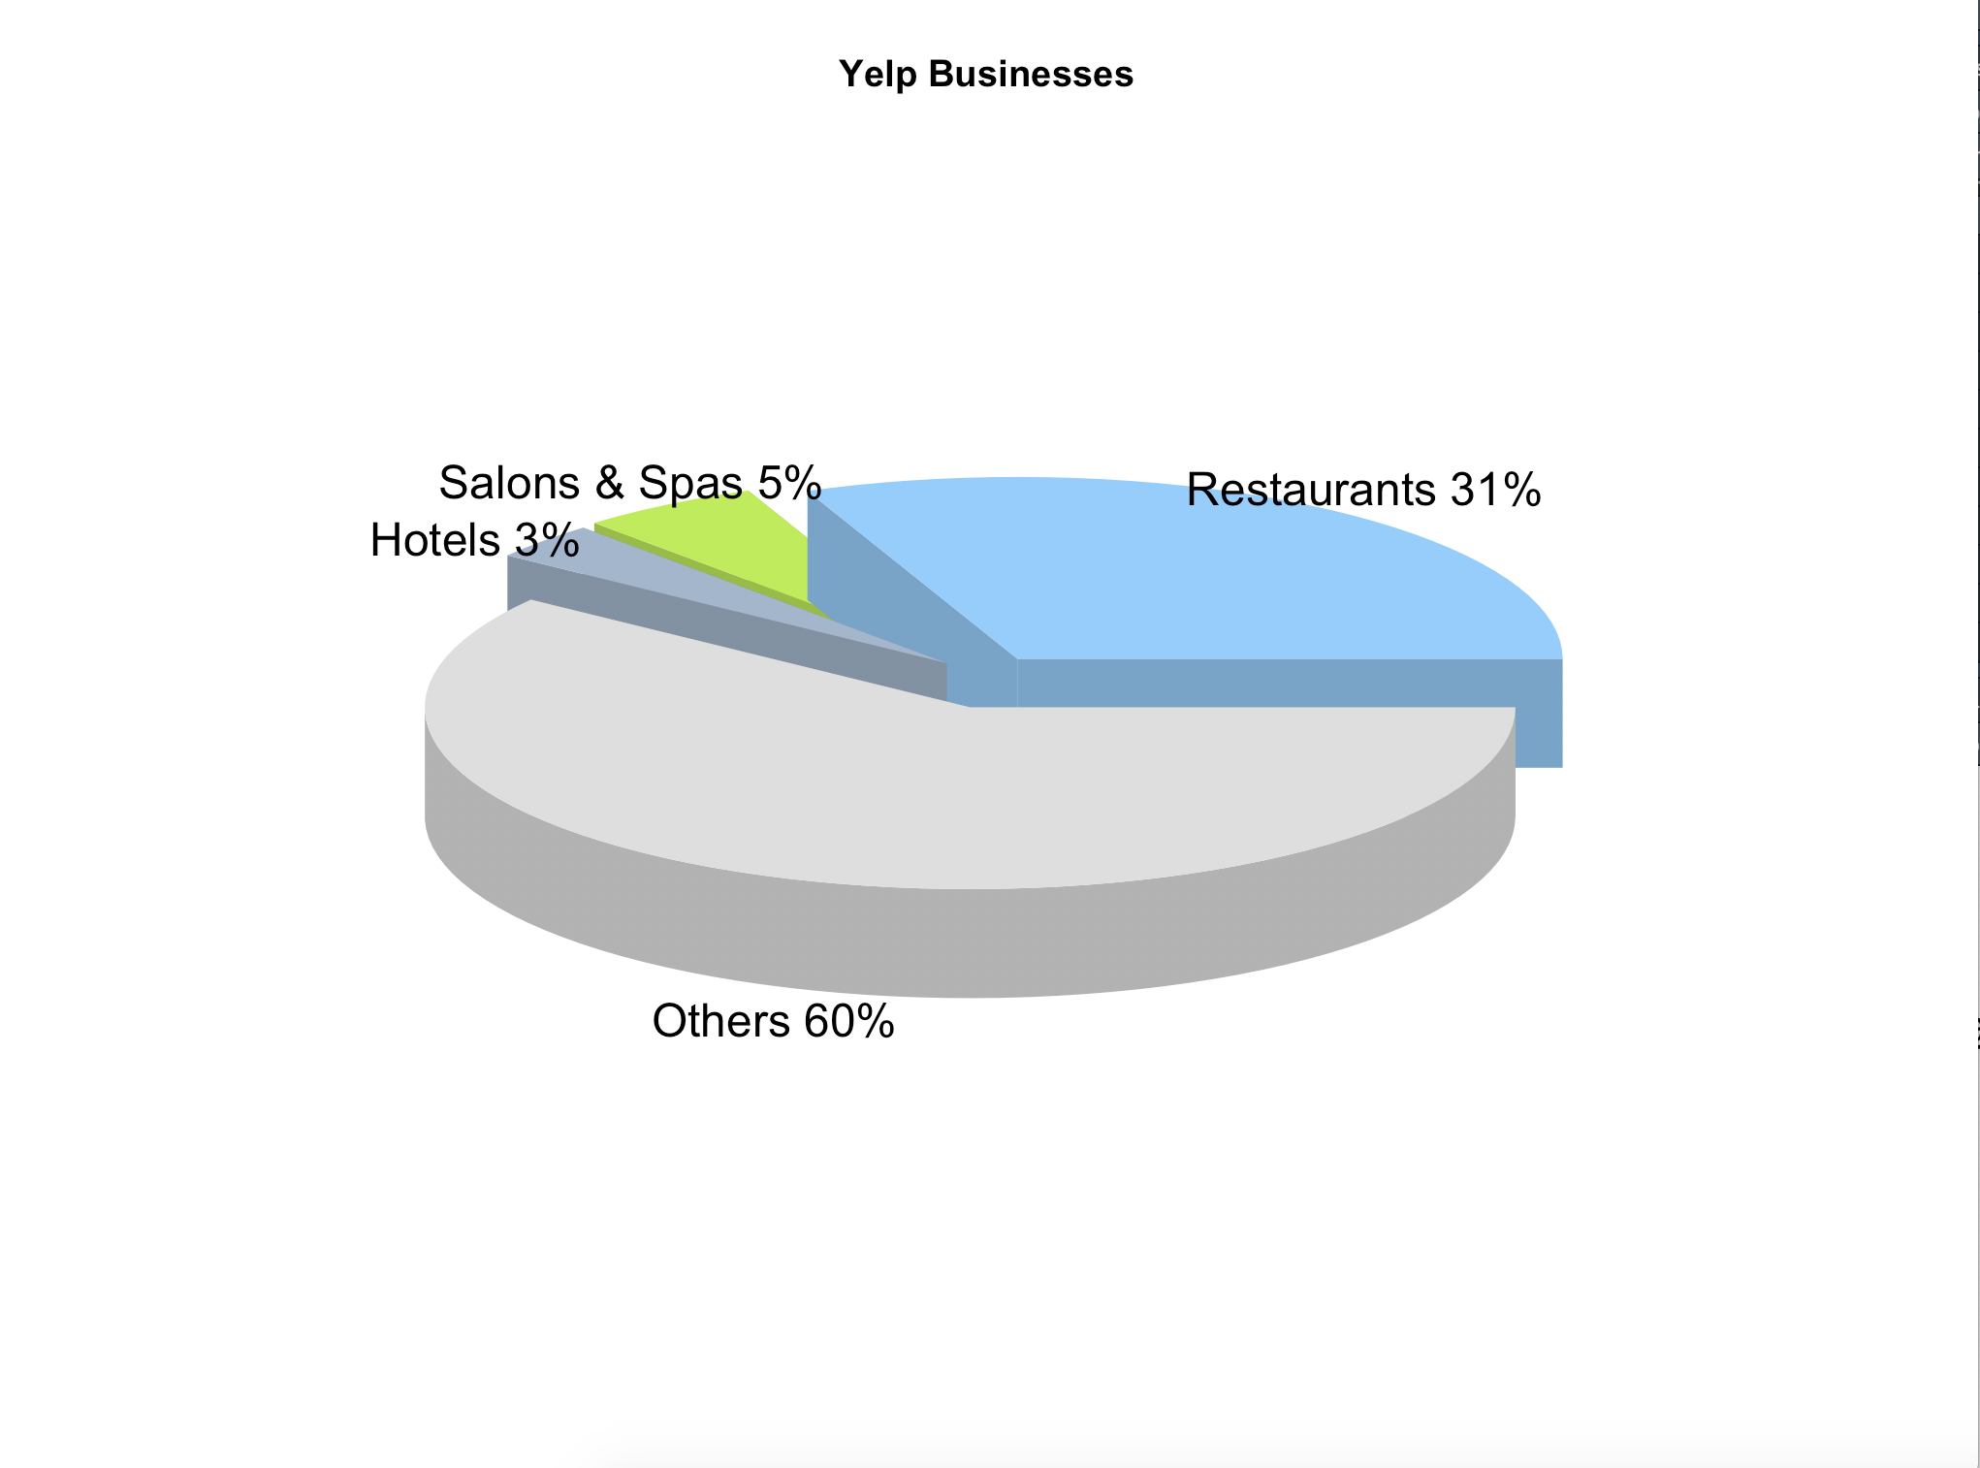
Data
Selection
Focus on restaurants only
1

Slide 9
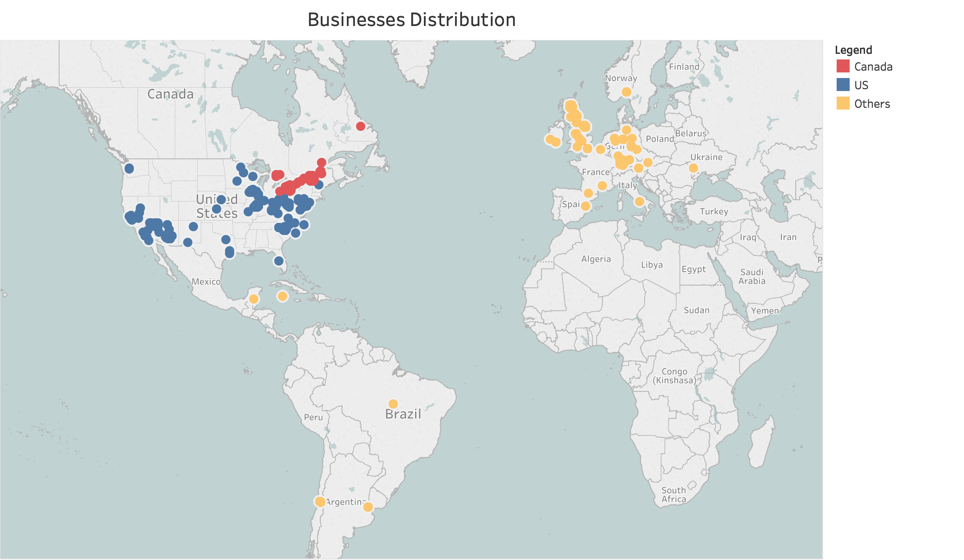
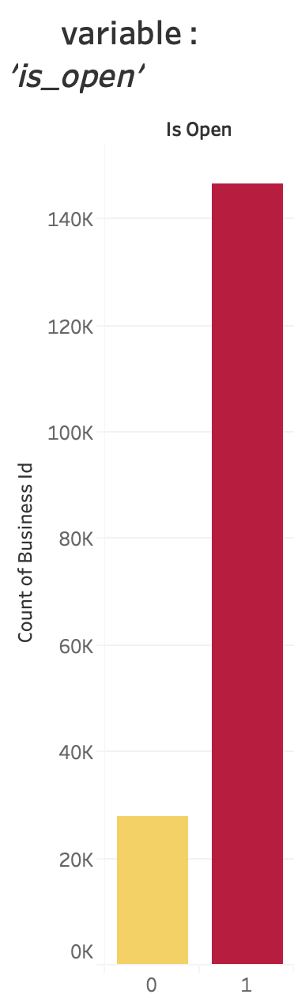
Data
Selection
Regroup 'state' in yelp_business
to visualize countries:
2
Created dummy variables 'is_ca', 'is_us', 'others'
kept observations in Canada 'is_ca’ to deliver more focused analysis
‘Is_open’: keep business that are still open
Notes:
Have pretty evenly distributed data in these 3 region
So we just want to focus on business in Canada which is opening

Slide 10
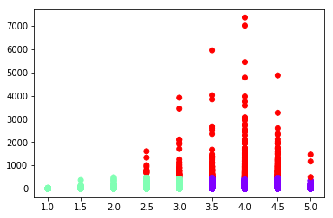
Data
Selection
Clustering Algorithm
3
Review count
Star Rating
Cluster (2 Dimension--Rating and Review count)
We collected info based on Cluster 2 (red) only (with high number of review but different rating across from low to high)

Slide 11
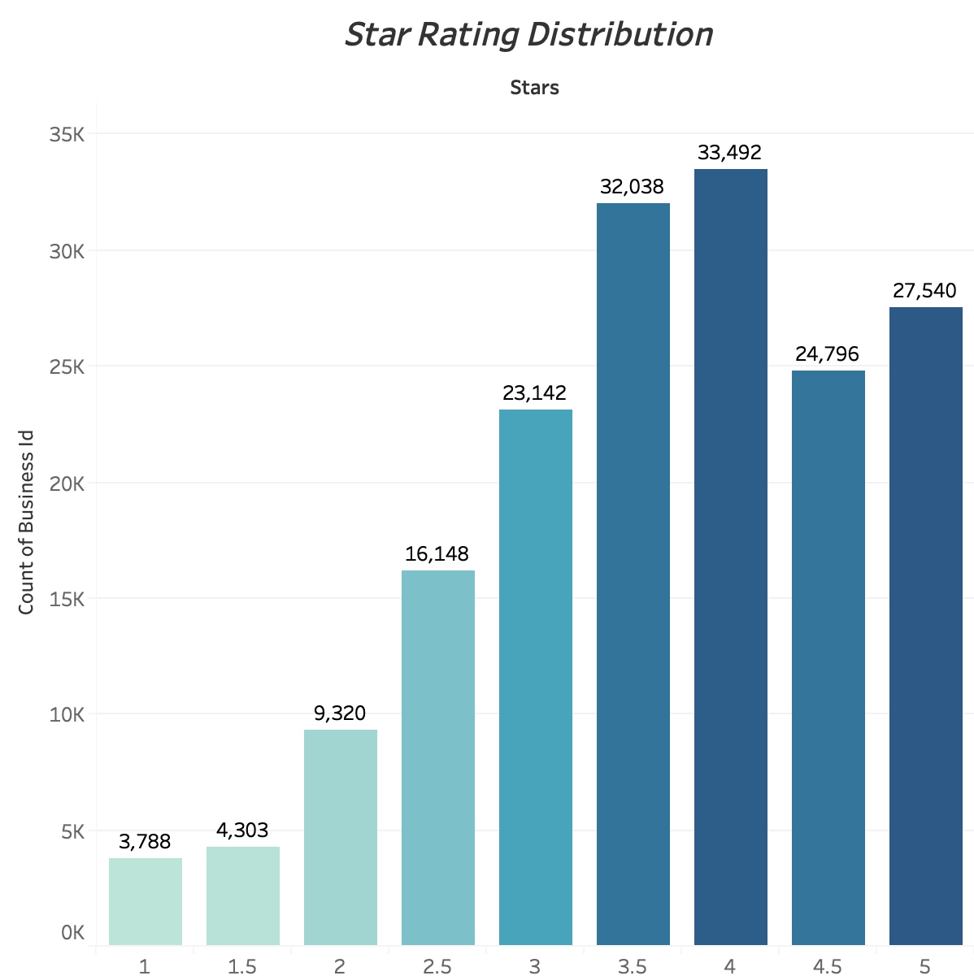
Data
Selection
Selected High Performanced Restaurants
4
5
Defined High Performanced Restaurants based on Star Rating
Selected Restaurants with Star Rating >= 4

Slide 12
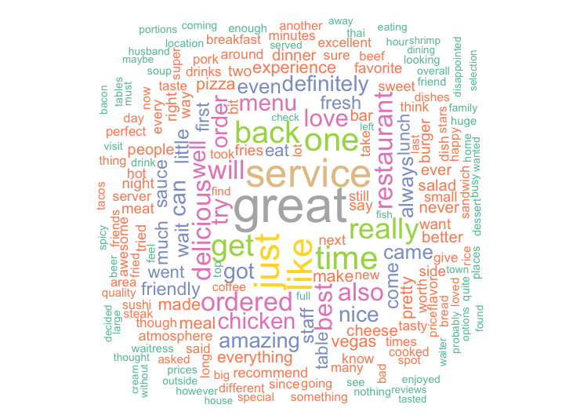
Data
Selection
High Frequency Words in Reviews
6
Merged Business Table with High Rating restaurants and Review Table
Random selected 3000 reviews
Used Text Mining to collect the high frequent 13k words from each review selected

Slide 13
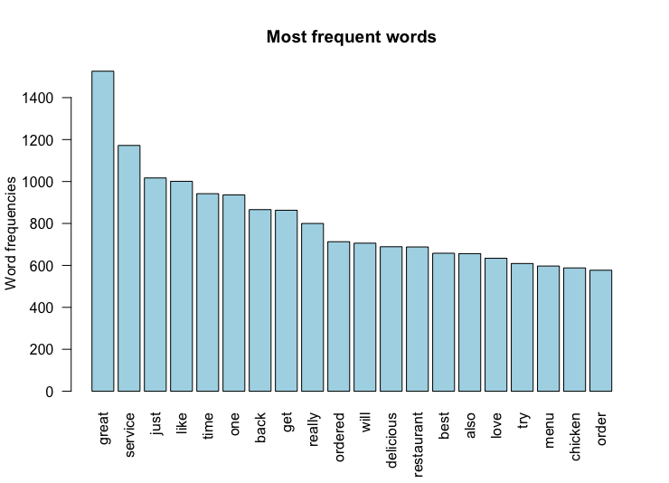
Data
Selection
Hand-Picked the Testing Word List
7
Exclude words “just”, “one”, “really”, “ordered”, “will”, and etc
Included words with meaning behind it only
Selected 64 words as our testing word list

Slide 14
Data
Mining
Techniques

Slide 15
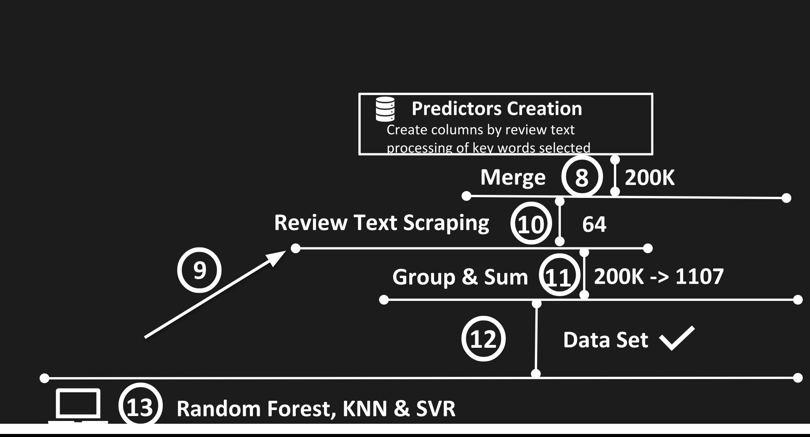
Predictors Selection

Slide 16
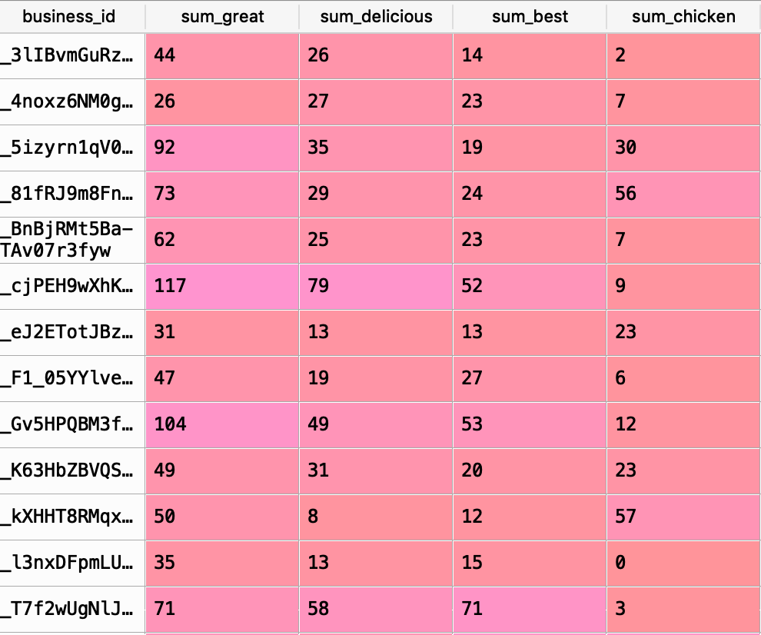
A Glance of the Final Dataset
Dataset Example
12

Slide 17
SVR
Supervised Learning to predict the rating
MSE: 0.14386
Cluster
Data
Mining
Techniques
Used clustering to subset data we want to focus on
Random Forest
KNN
Supervised Learning to select the important features
MSE: 0.02276
Unsupervised Learning to predict the rating
MSE : 0.15969
With K = 10

Slide 18
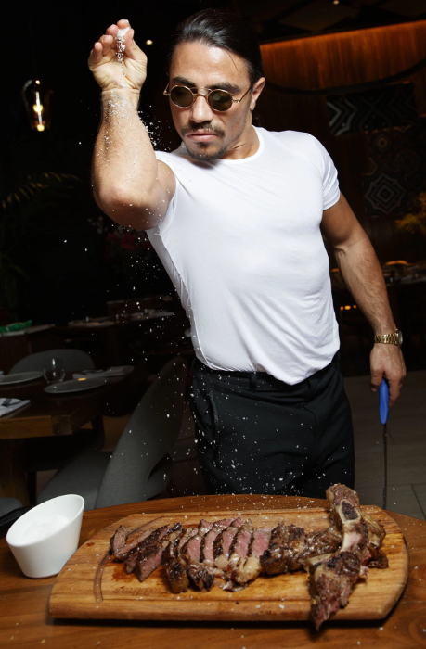
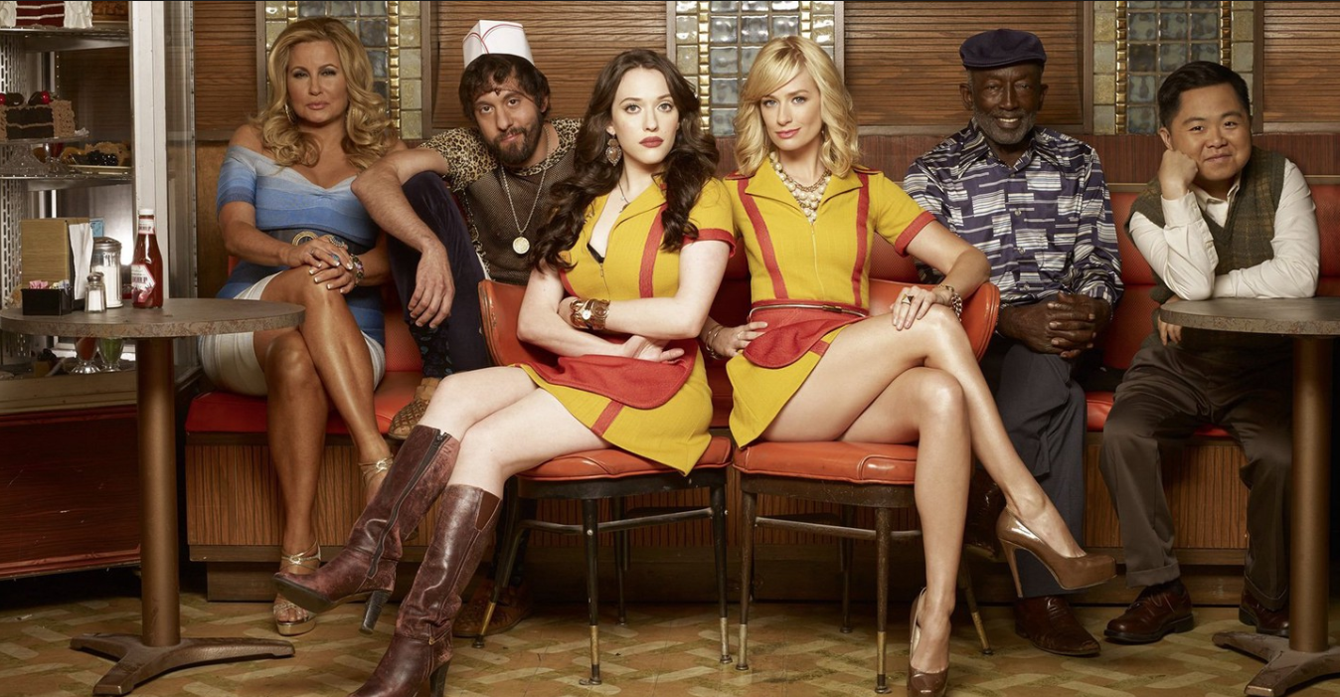
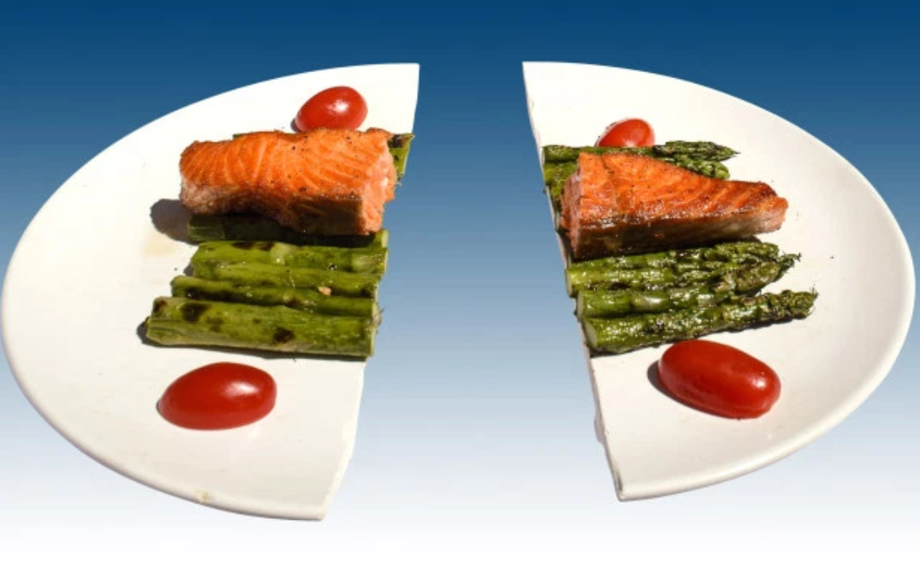
Top 10 Attributes
Business Opportunities
Predictor Gini coefficient
Sum_delicious 0.255549
Sum_server 0.134198
Sum_decent 0.096251
Sum_amazing 0.031357
Sum_waitress 0.021364
Sum_waiter 0.020319
Sum_friendly 0.019353
Sum_price 0.019350
Sum_excellent 0.018842
Sum_perfect 0.015762
Budgeting and the shifting of service focus
Food quality, availability and variety to give more customization
Waiters and waitresses are the face the restaurants
E.g. manner, appearance
Split dish to give sharing experience and marginal utility of paying one for two dishes

Slide 19
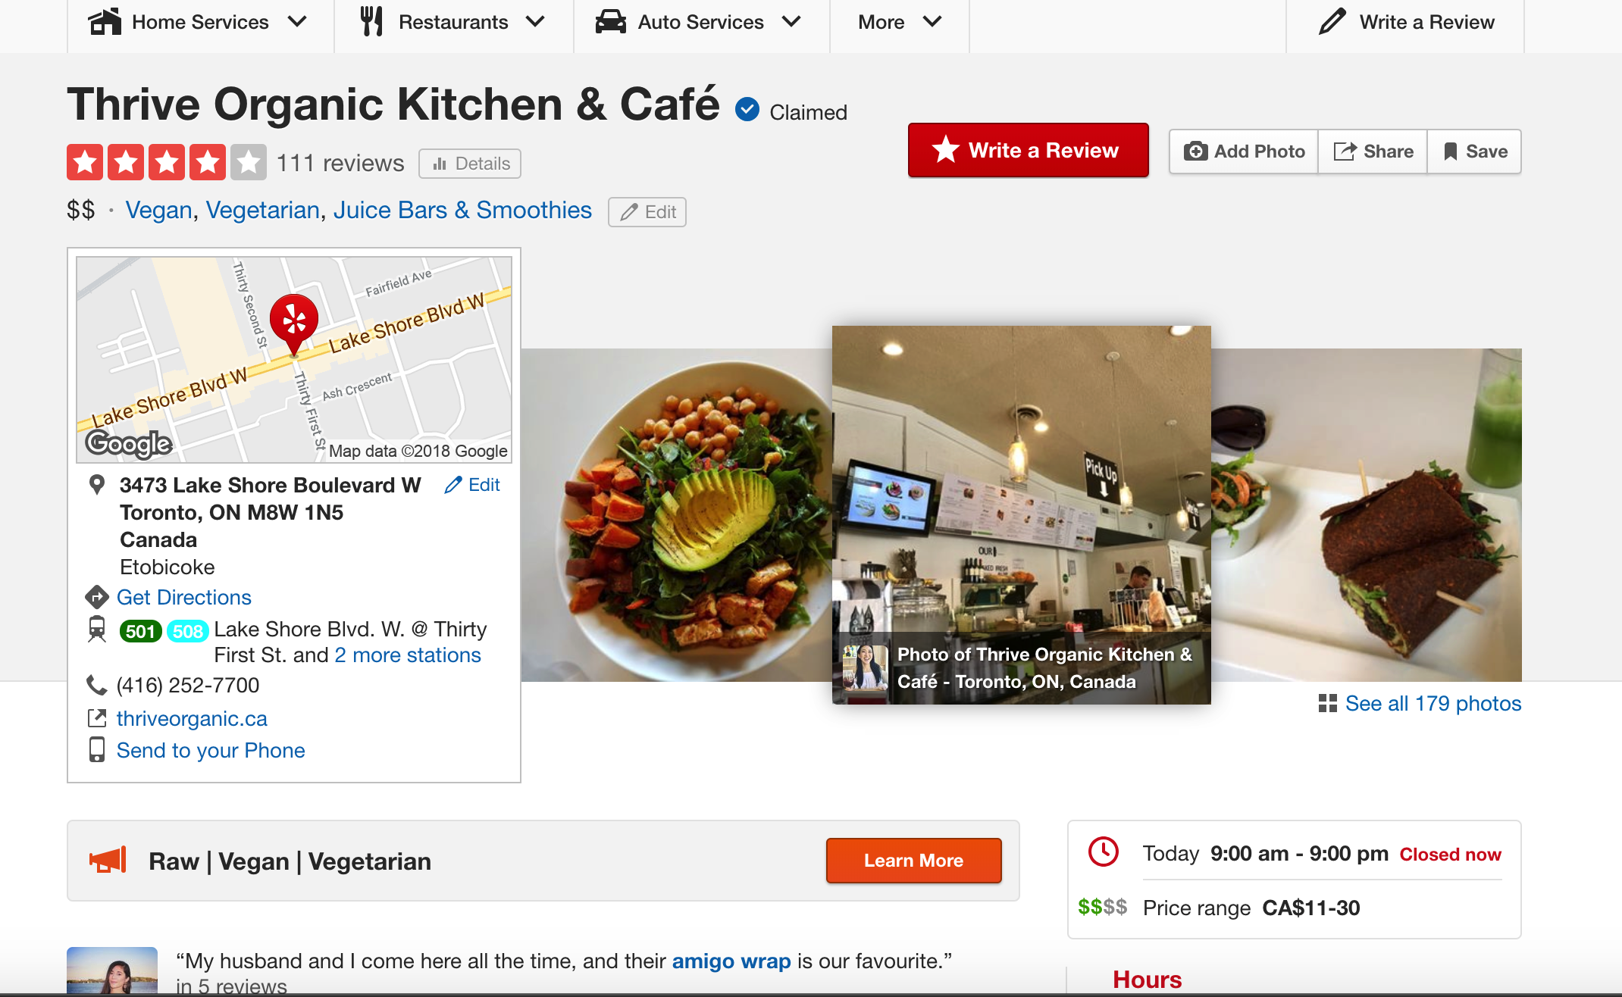
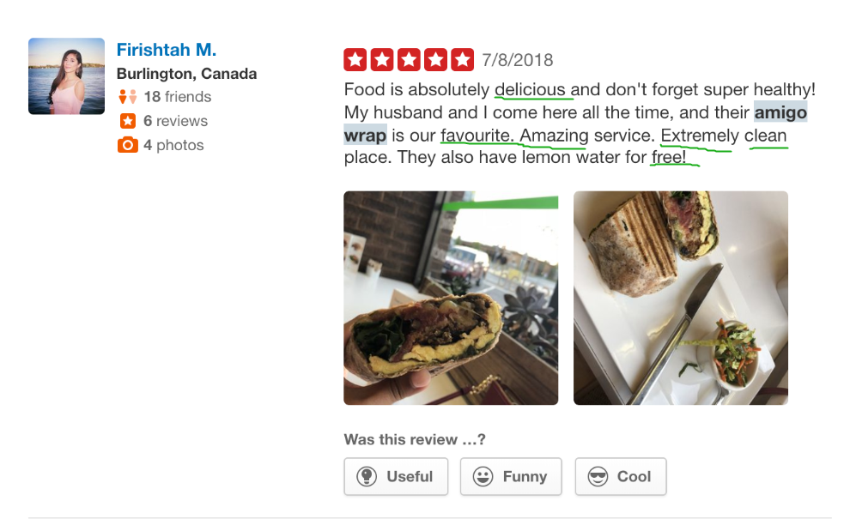
Review Example

Slide 20
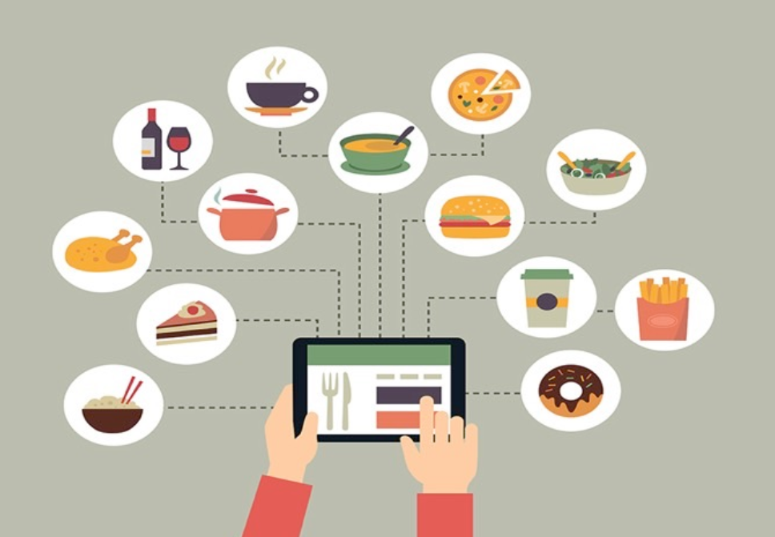
Bottom 10 Attributes
Business Opportunities
Predictor Gini coefficient
sum_green 0.004088
sum_clean 0.004027
sum_meat 0.003976
sum_fun 0.003943
sum_free 0.003943
sum_quite 0.003769
sum_pork 0.002738
sum_wife 0.002537
sum_thai 0.001856
sum_ramen 0.001803
No longer to pay more attention to these aspects during the service
Maybe the standard of the industry
Change of spending allocation

Slide 21
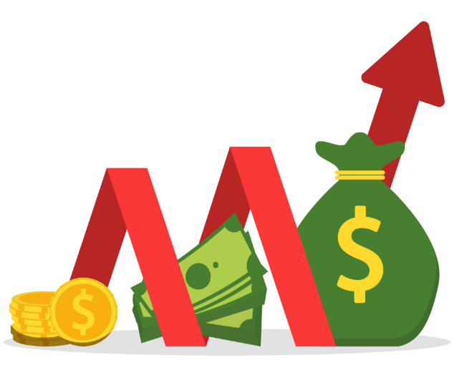

Outcomes
More efficient budget allocation
Improving yelp rating and word-of-mouth reputation
More revenue and better profitability
E.g. Higher rev/profit per dollar spent
Higher return on investment (ROI)
Customer and employee satisfactions

Slide 22
Thank You!
Q&A?

